Slide 1
Email Marketing Course

Slide 2
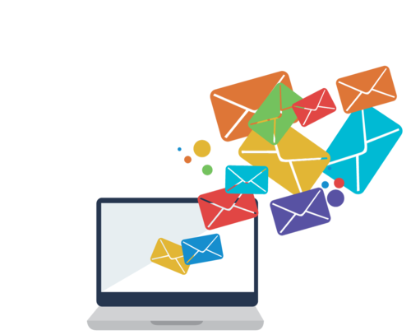
Email Marketing Plan Course
Chapter 1: Why Email Marketing Introduction & important Statistics. Chapter 2: Email Marketing Strategy Email List, Lead Magnet & Content
Chapter 3: Tactics & Actions Email Marketing Software & Automation Chapter 4: Control Track, Optimize & Improve
Chapter 5 : Bonus Chapter mailchimp detailed walkthrough

Slide 3
Chapter 1: Why Email Marketing ? Introduction & Important Statistics

Slide 4
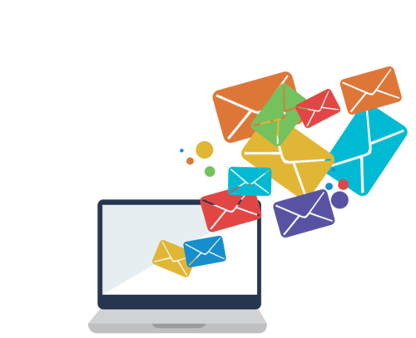
Email Marketing Definition
Email marketing is the digital marketing practice of communicating with leads and customers with email.

Slide 5
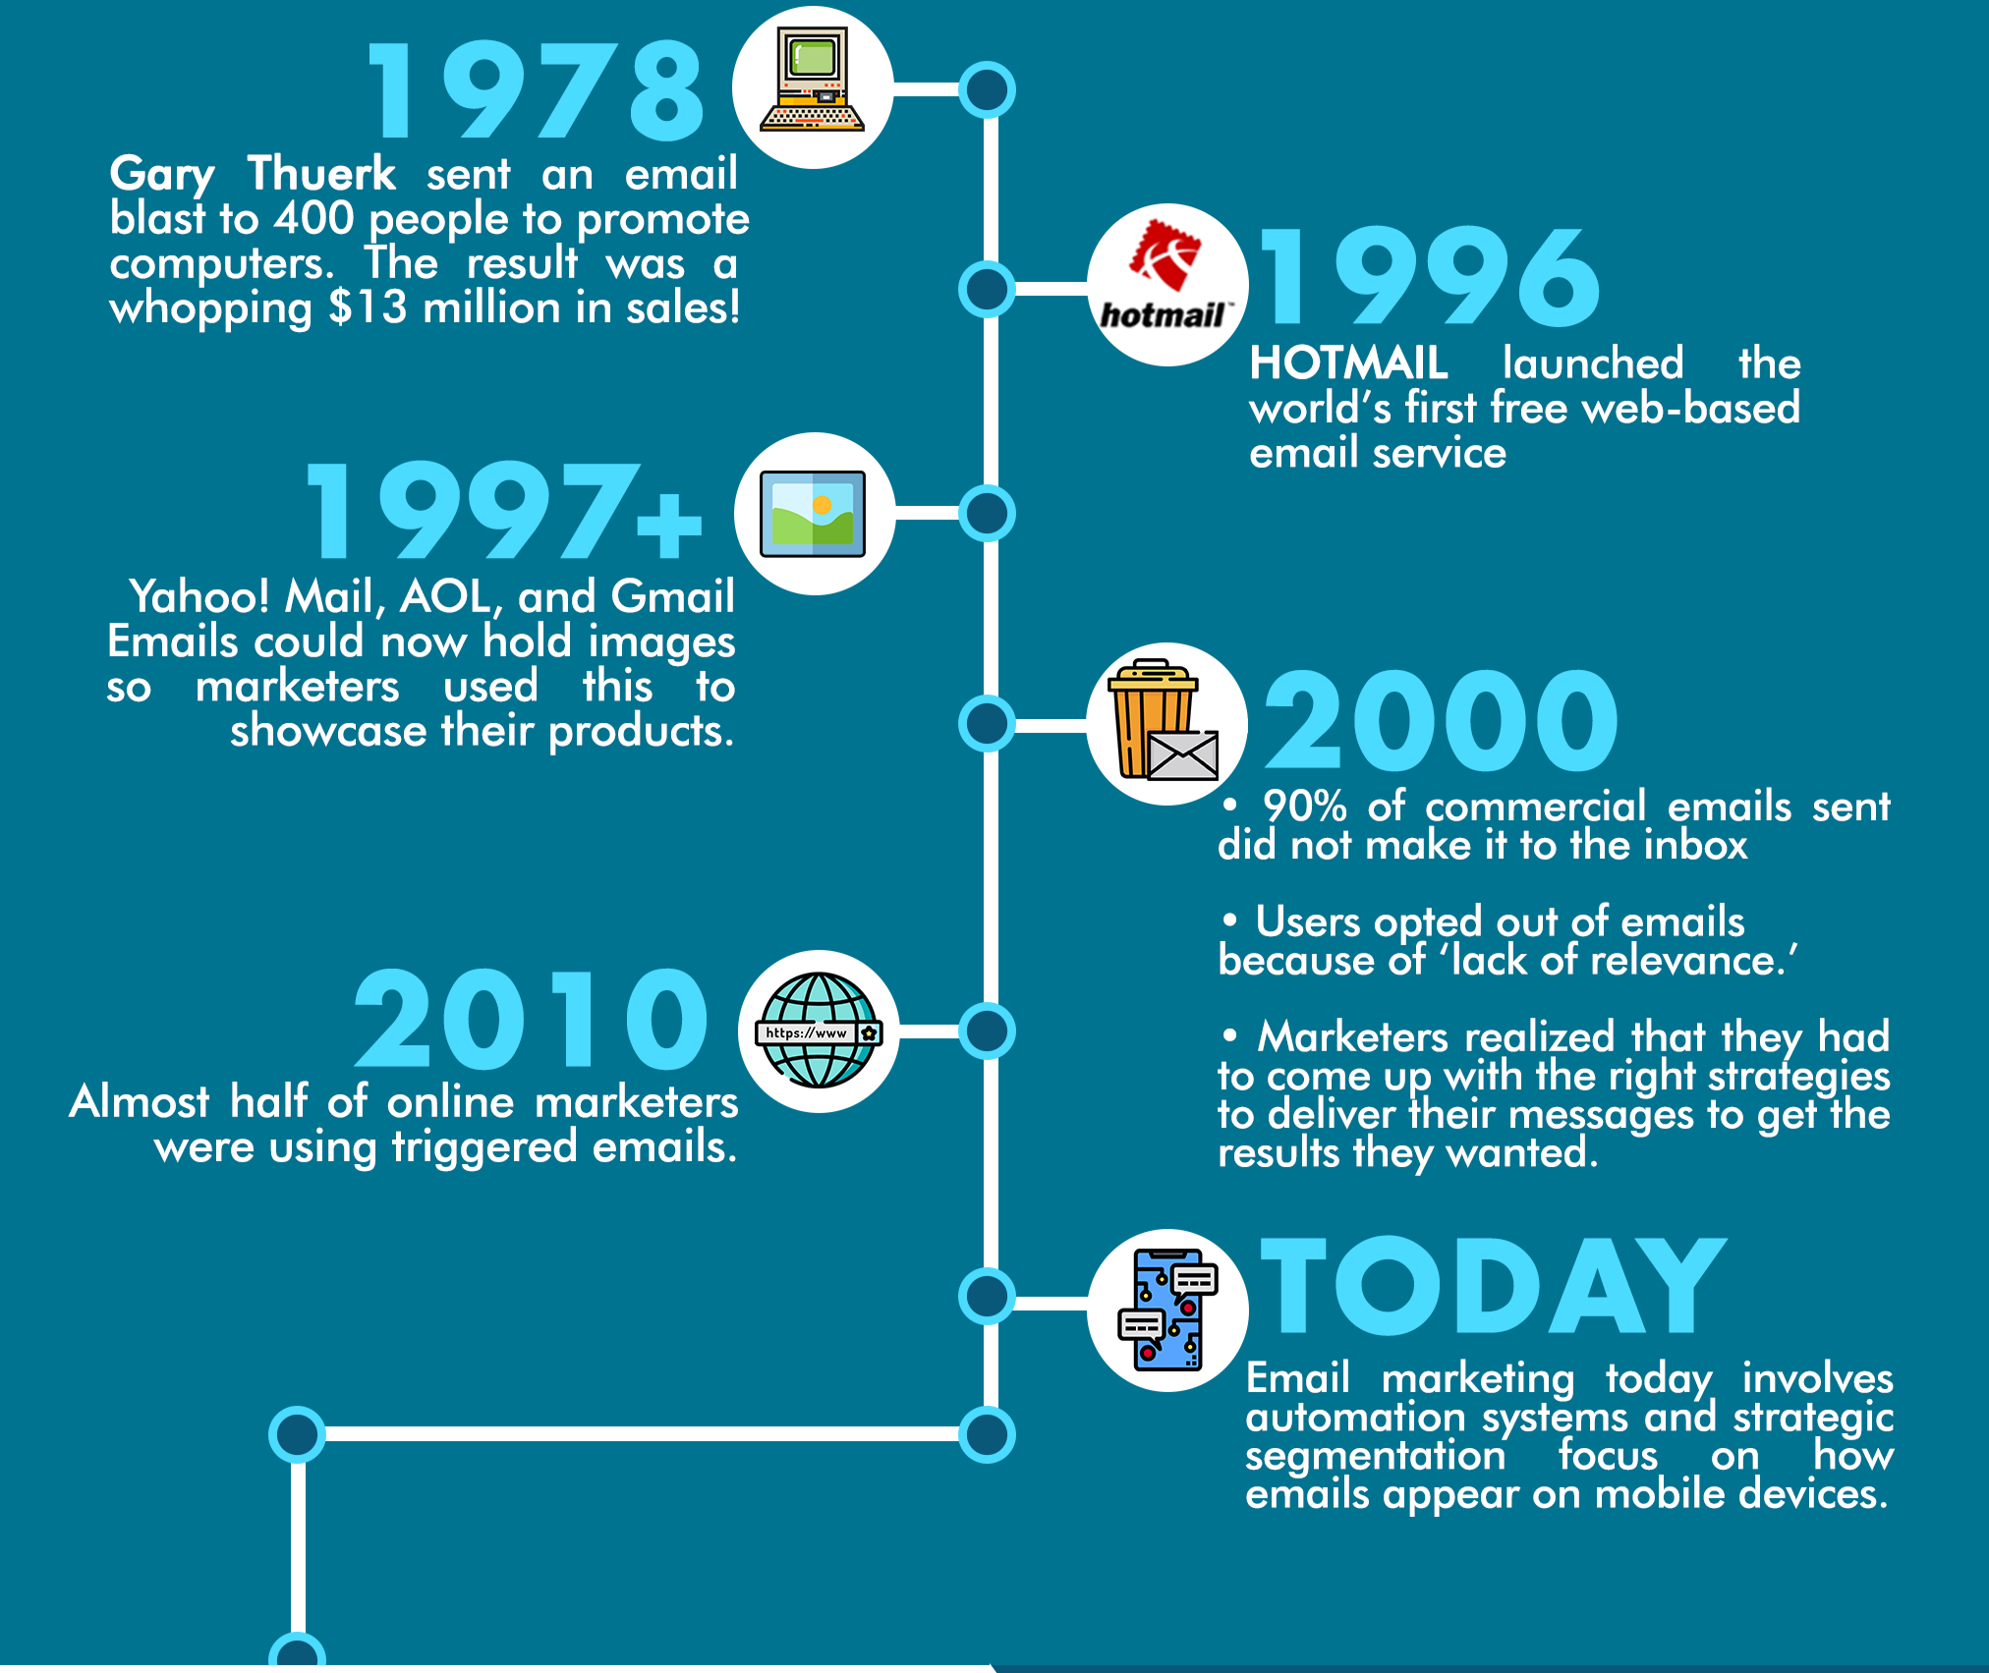
Timeline & Evolution of Email Marketing

Slide 6
New Email Marketing techniques

Slide 7
3-/47-/50 rule in E-Commerce
3% of visitors will buy.
47% of them aren’t ready to buy immediately, but intend to make a purchase sometime in the future.
50% of visitors will never buy.

Slide 8
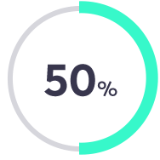
50% of leads
are qualified but not yet ready to buy.
(Source: Gleanster Research)

Slide 9
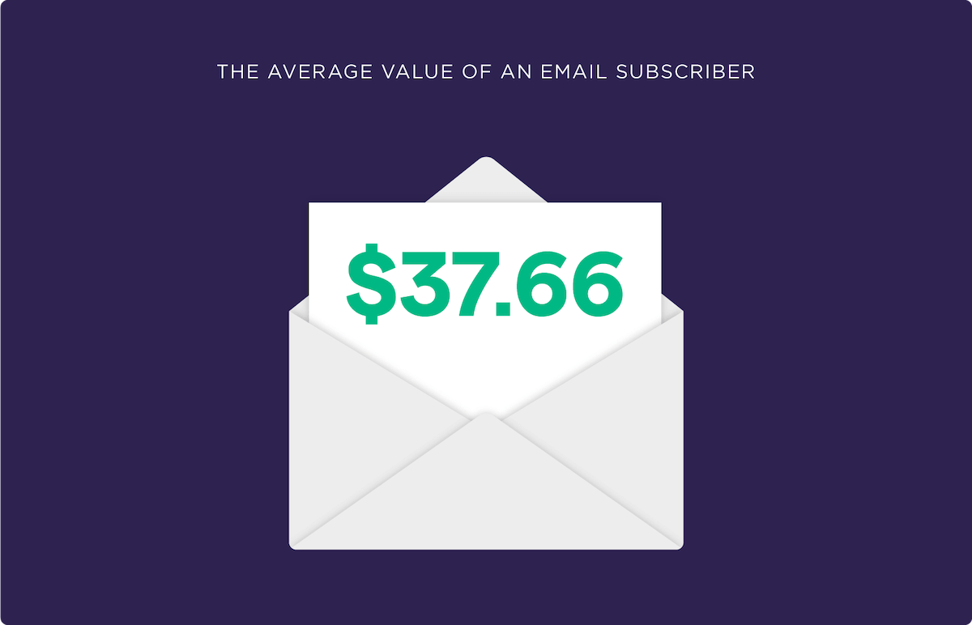
Does Email Marketing Still Work?
why email marketing still works GREAT.
The average email subscriber is worth $37.66 (Source: DMA).
DMA: Direct Marketing Association

Slide 10
Email Marketing ROI
For every $1 spent, email marketing generates $38 in ROI.(Source: Litmus)

Slide 11
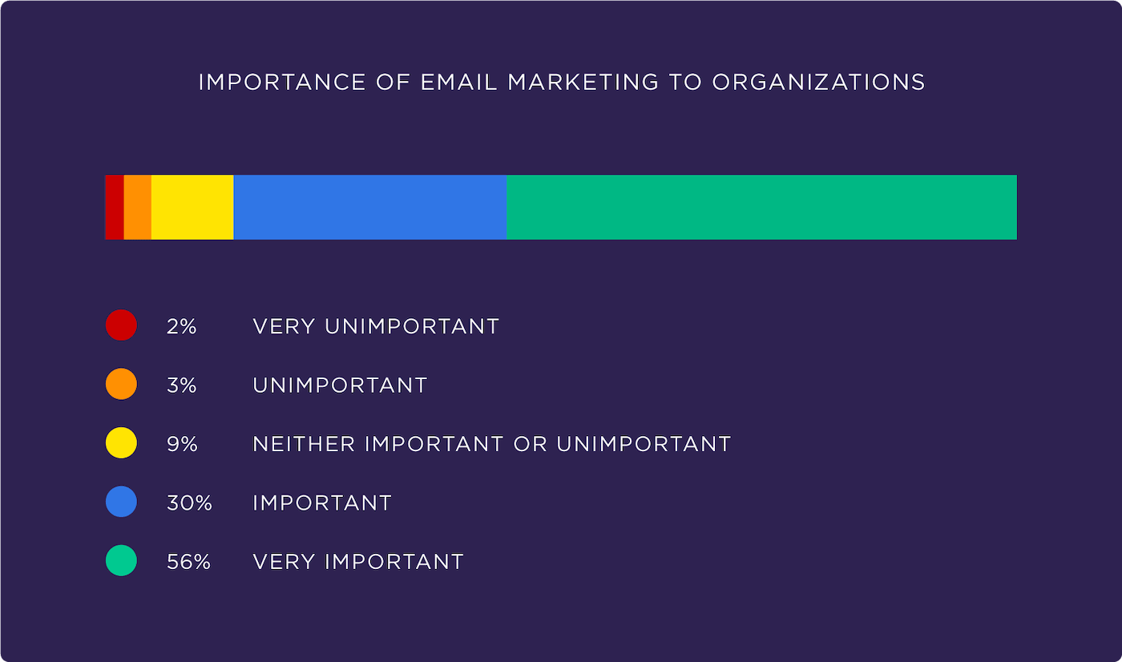
This super high ROI is probably why 86% of marketers consider email “important” or “very important” (Source :DMA).

Slide 13
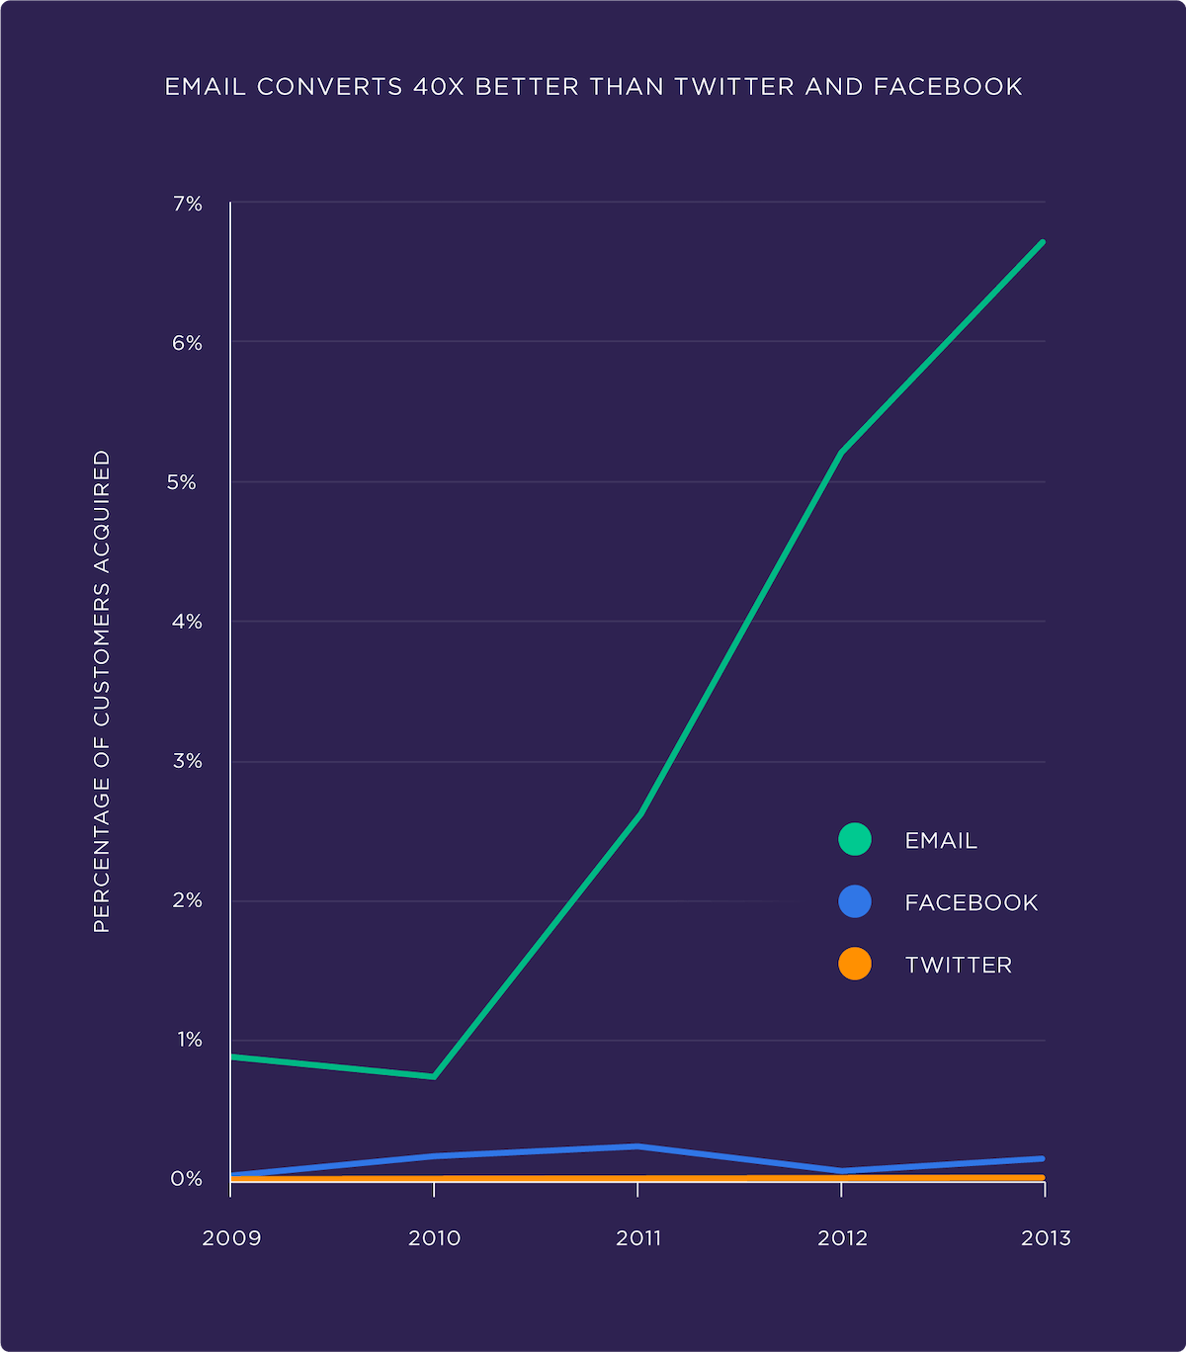
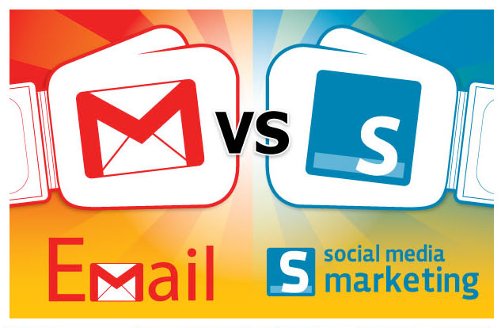
Email Converts REALLY Well
Email converts 40x more leads into customers than Facebook and Twitter combined (Source: McKinsey).

Slide 15
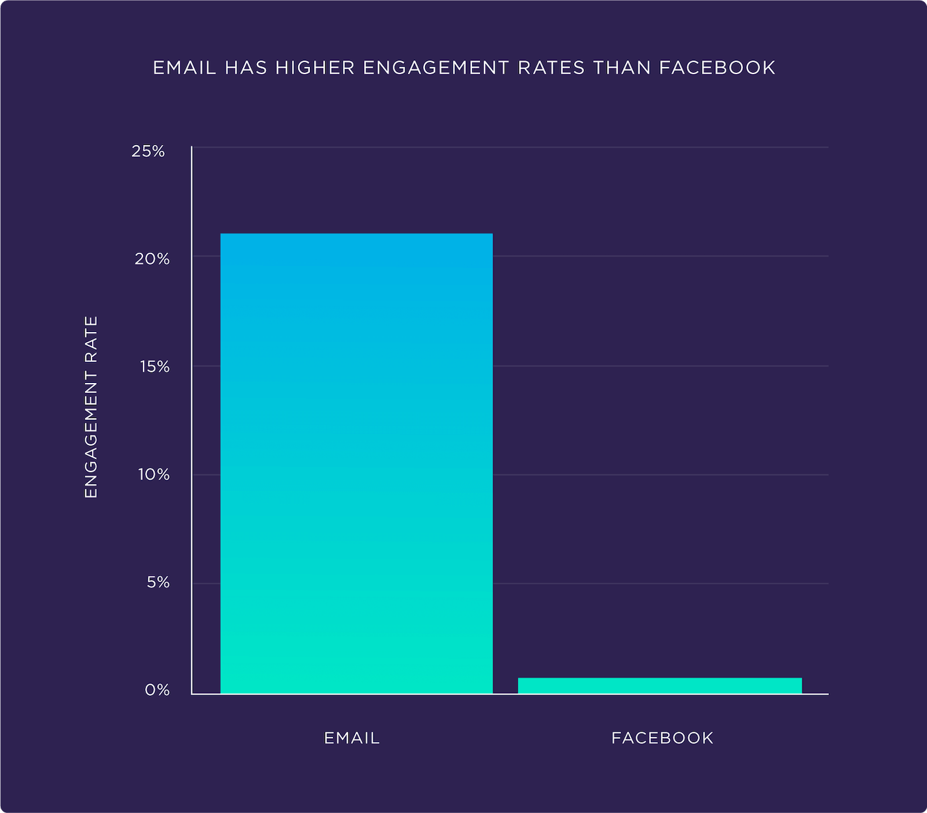
In fact, a 2019 study found that Facebook organic engagement decreased to less than 1% (RivalQ)

Slide 16
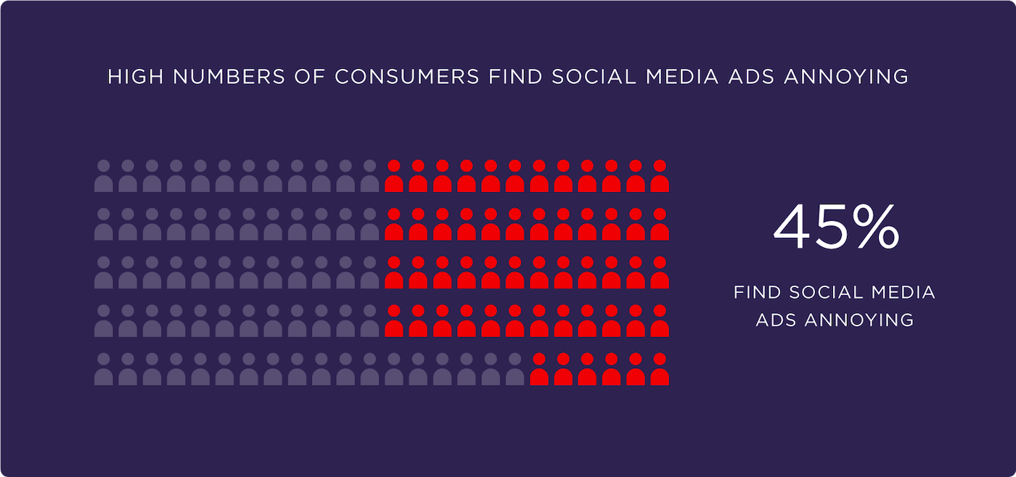
Marketing Messages via Email
In fact, 45% of consumers report that social media ads are annoying (AdWeek).
For example, one study found that 86% of consumers prefer to get email-based marketing messages over Facebook ads, TV commercials and display ads (HubSpot).

Slide 17
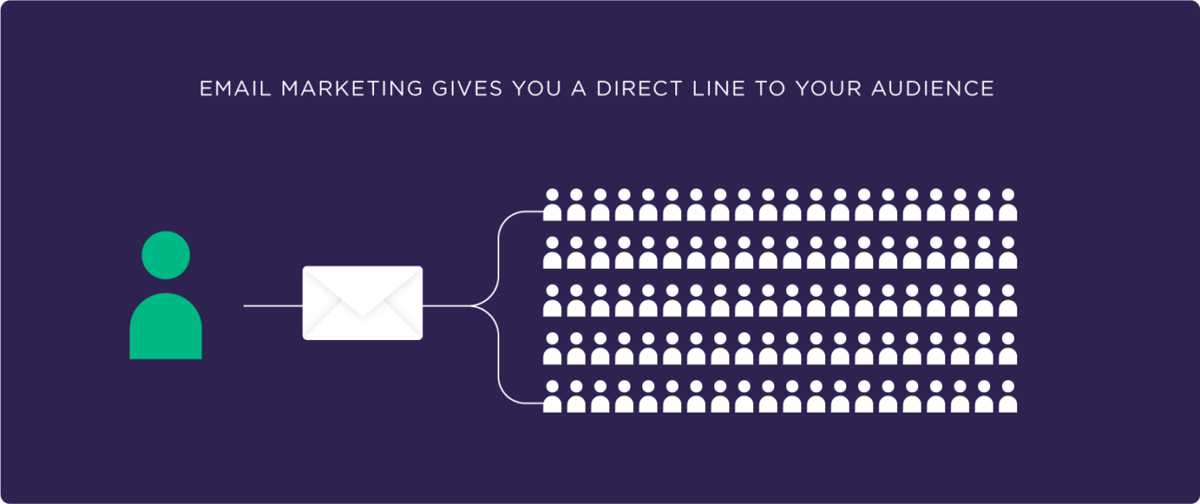
The #1 thing that makes email marketing more effective than SEO and social media is that you have a direct line to your audience.

Slide 18
E-Mail vs Social Media
A message is 5x more likely to be seen in email than via Facebook.
24% of visitors from email marketing buy something as compared to 2.49% of visitors from search engines and 0.59% from social media.

Slide 20
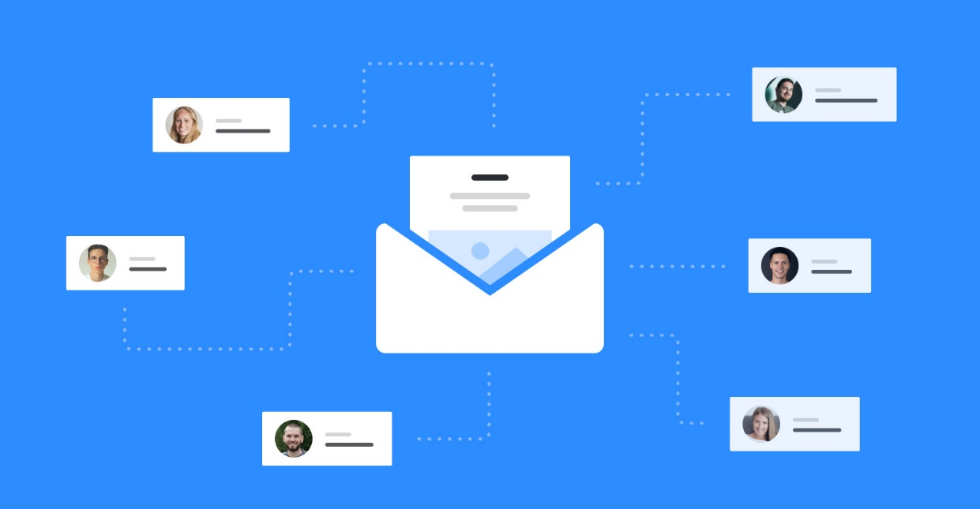
Healthy Email List
You can see that email marketing can be really effective – if you have a healthy email list.
A healthy email list contains visitors who are actually interested in your products.

Slide 21
Email Lists could be :

Slide 22
The Goal with Email Marketing is to cultivate relationships with your customers.

Slide 24
Drip Campaign

Slide 25
Email Marketing Plan
1-Situational Analysis
Review the latest statistics and trends related to email Marketing Review & update your latest Email List and campaigns.
2-Objective Put a SMART objective to reach from your Email Campaigns : the 5S’s ( Speak,Serve,Sell & Sizzle) 3-Strategy
1-Build New Email List. 2-Lead Magnet 3-Email Content Plan (Email Types, Email Sequence (Drip Campaign) ) 4-Tactics & Actions :
Sign up for email marketing software: eg.Mailchimp
Automate the process: setup an auto responder that automatically sends new subscribers helpful content.
5-Control :
Tarck, Optimize & Improve: improve your email marketing based on open rates, click-through-rates, conversions, unsubscribes and feedback from subscribers.
Chapter 1
Chapter 2
Chapter 3
Chapter 4

Slide 26
Chapter 2: Email Marketing Strategy

Slide 27
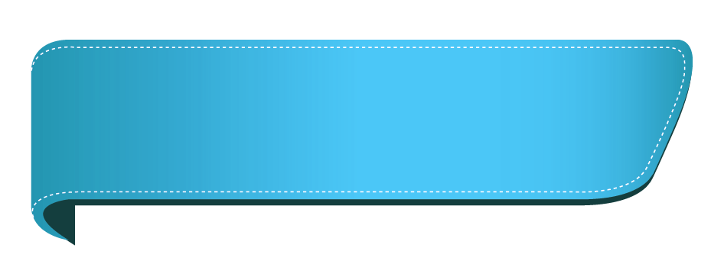
1-Build New Email List
Email Marketing Strategy
2-Create Lead Magnet
3-Email Content Plan (Email Sequence (Drip Campaign) & Email Types, )

Slide 28
1-Build New Email List

Slide 29
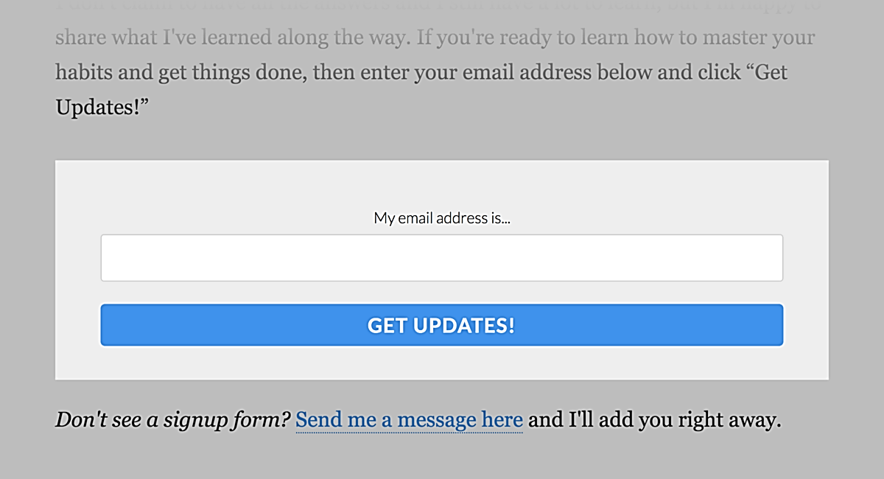
Build a new Email List
Sign up forms
Add Sign Up Form in your website.
Put at least one email sign up form on your about page in your website.

Slide 30
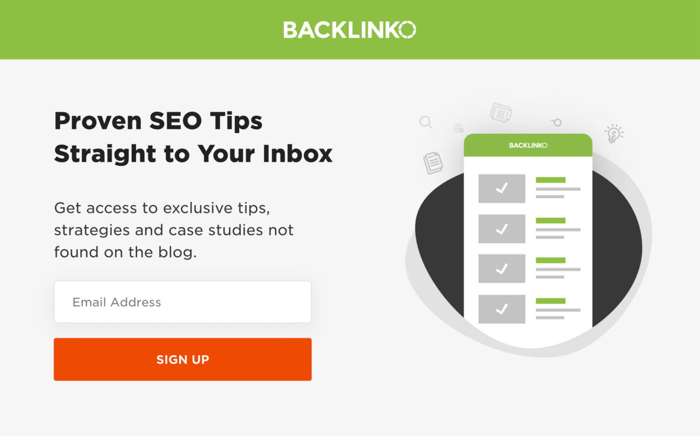
Create Squeeze Pages (pop up)
If you’re serious about building your email list you NEED a squeeze page.
(In other words: a page designed to convert visitors into email subscribers).
Here’s an example from backlinko website.

Slide 31
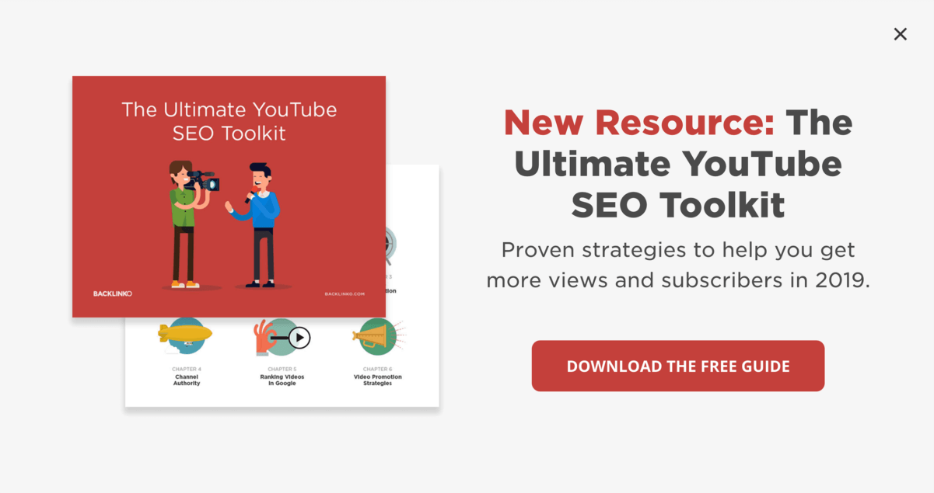
Exit-Intent Popups
We all don’t love popups But Exit-Intent Popups are the best.
Not only does it offer something cool, but this popup only appears if you’re leaving the site anyway.

Slide 32
Other Email Building tools
We strongly recommend that you create our own website, but if you don’t, you still have different ways to build an email list.
Examples:
1-Facebook Lead Forms. 2-Google forms.

Slide 33
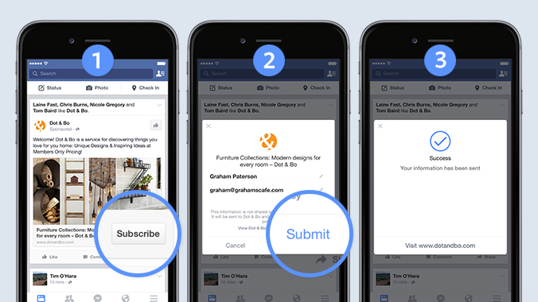

Slide 34
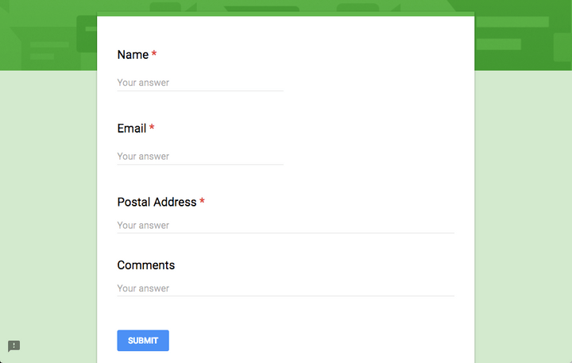

Slide 35
2-Create Lead Magnet

Slide 36
Create Lead Magnets
Lead Magnets are the lifeblood of any list building campaign. It’s the tempting bribe that will attract subscribers.
The more valuable your lead magnet, the more signups you’ll get

Slide 39
How to find your lead magnet

Slide 40
Lead Magnet Example

Slide 42
3-Email Content Plan (Email Sequence (Drip Campaign) & Email Types, )

Slide 43
Email Sequence (Drip Campaign)

Slide 46
Drip Campaign Example

Slide 48
Email Types

Slide 49
Email Types
1-The Content Newsletter
he Content Newsletter is a newsletter that provides 100% pure value.
The value can be in the form of a handful of tips. Or links to helpful resources. Or a personal story.
The exact type of value doesn’t really matter. As long as you don’t pitch anything, you’re good.
In fact, pure value newsletters are so rare that your subscribers will LOVE you for them.

Slide 50
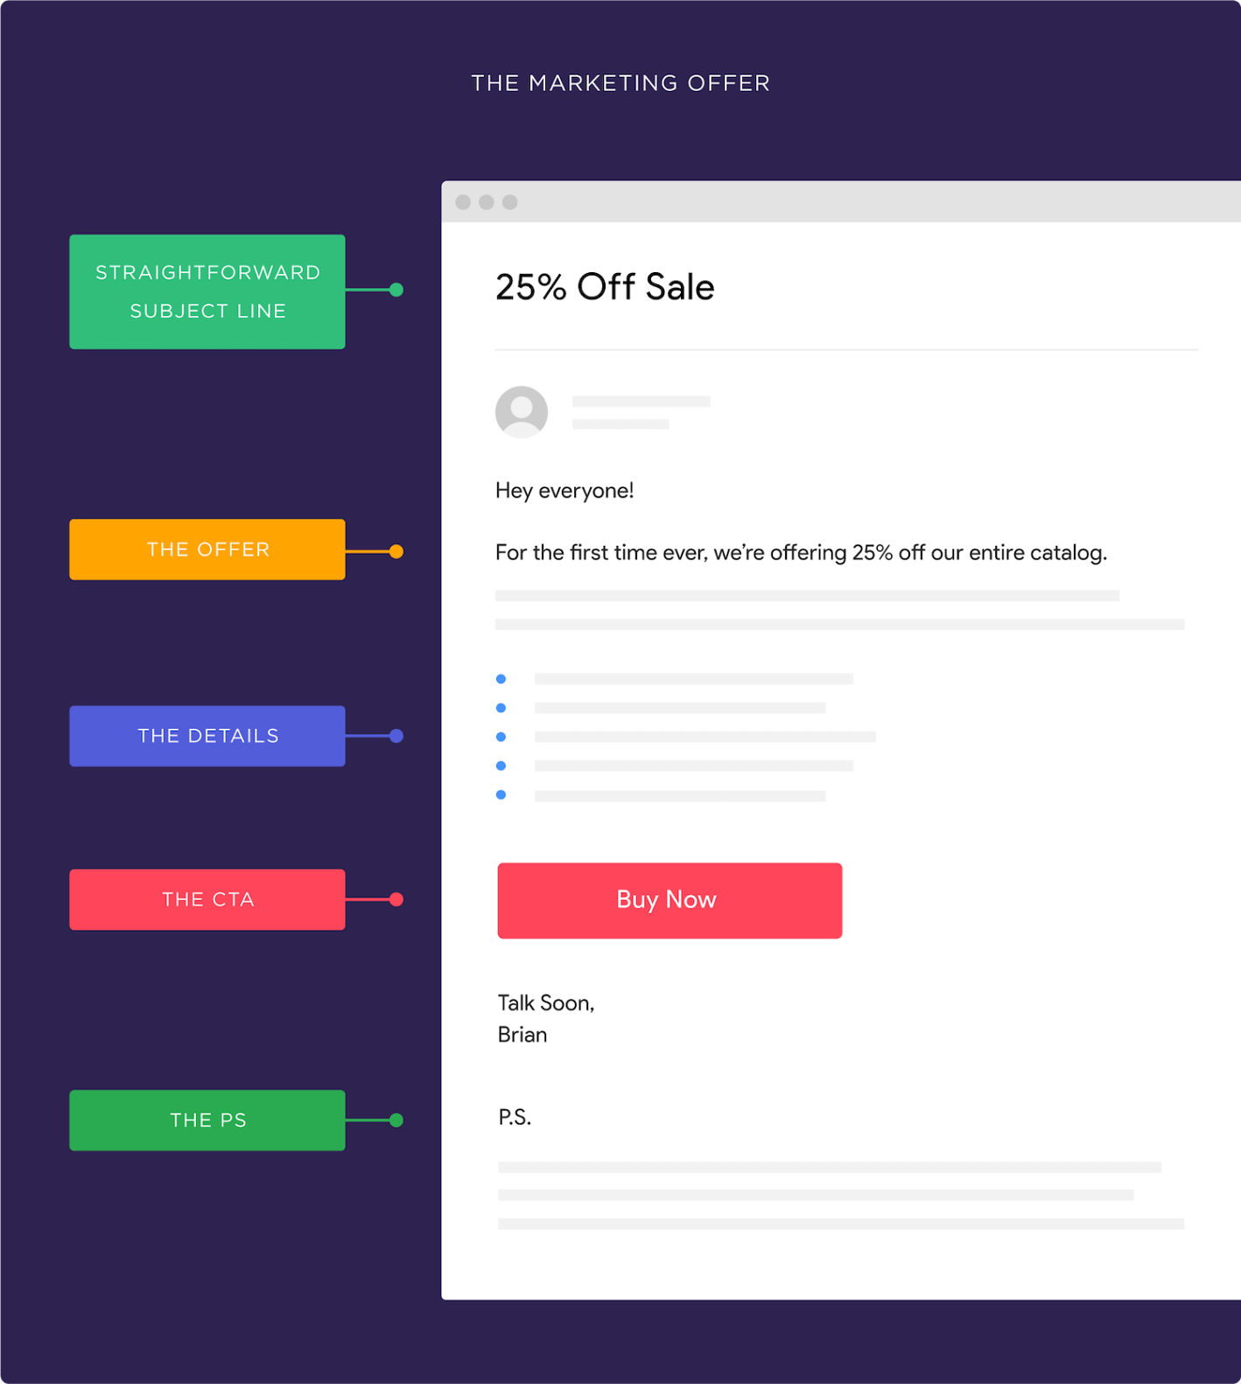
Email Types
2- The Marketing Offer
The Marketing offer is just like it sounds:
It’s an email that pushes your subscribers to make a purchase.
(Usually in the form of a limited-time sale).
Here’s the template to follow

Slide 51
Important Hint: The P.S. Note
A PS is an underrated little tactic that can easily double your conversion rate. Why?
Because lots of people will skim your message… but stop and read your PS word-for-word.
All you need to do here is summarize your offer and include another call-to-action.

Slide 52
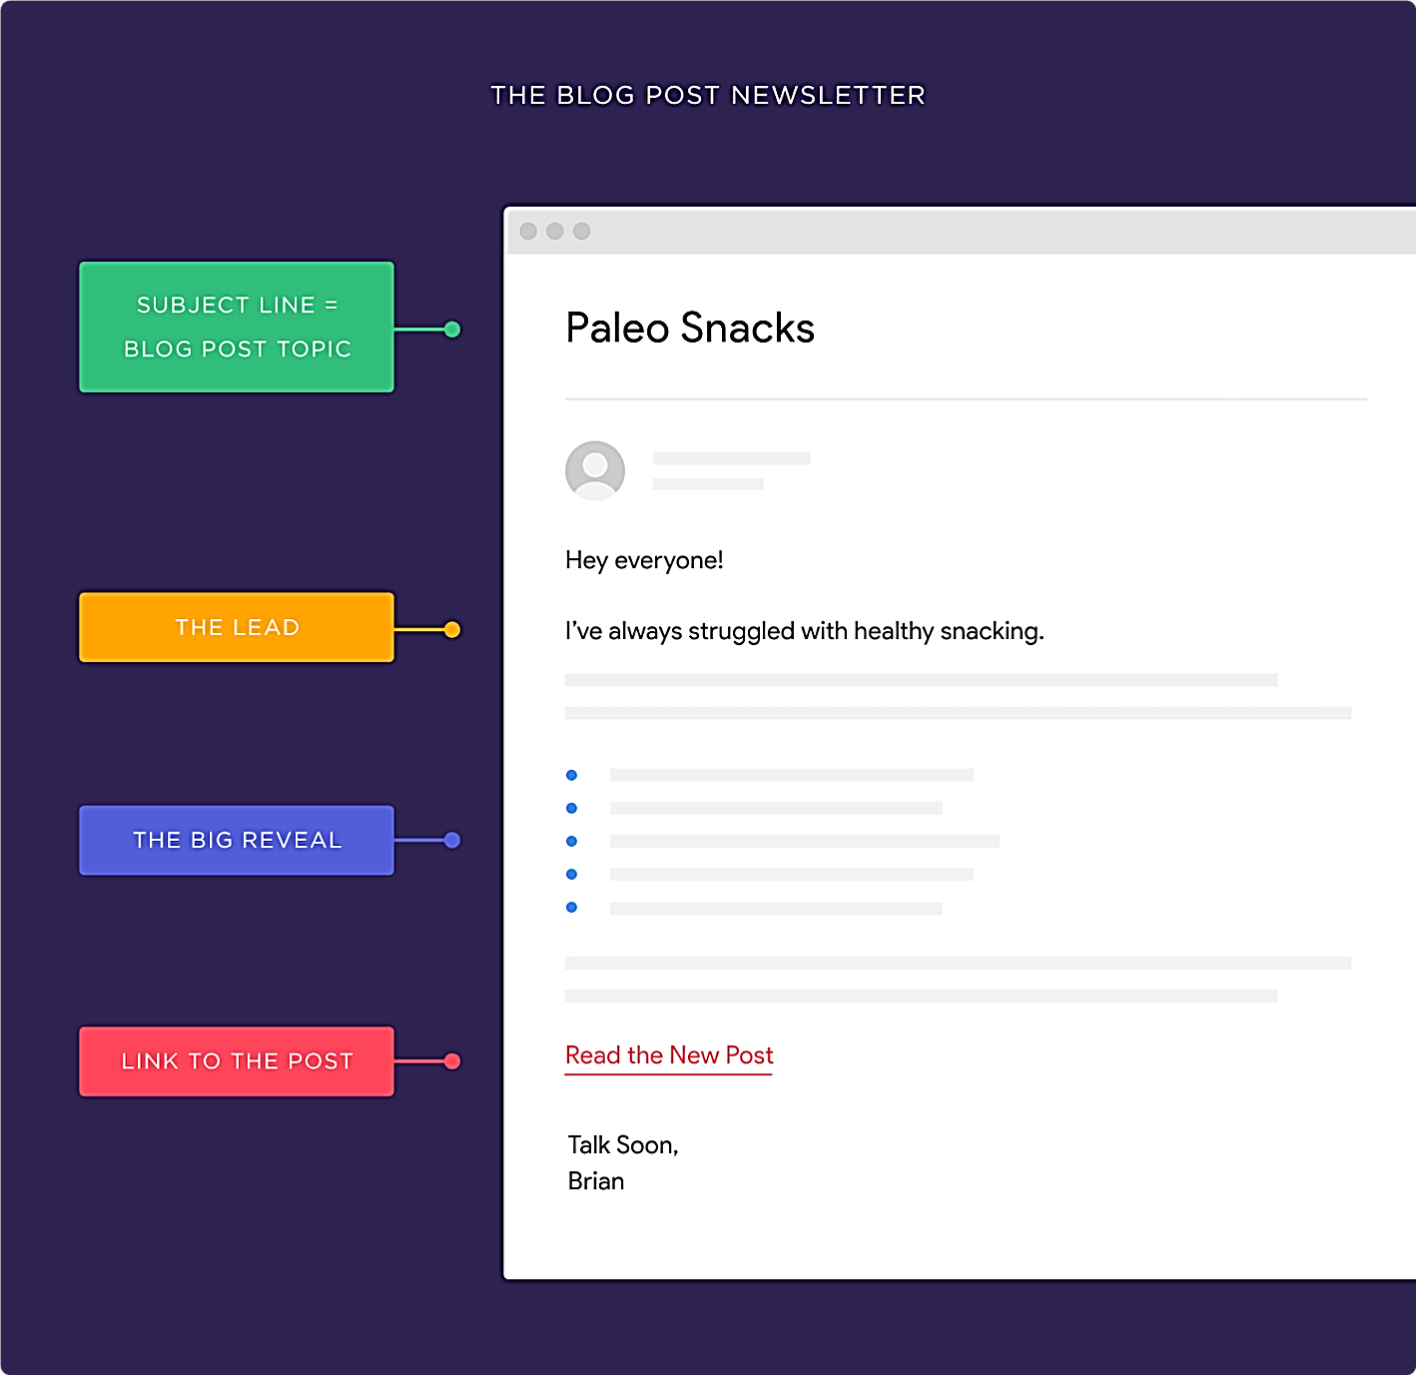
Email Types
3-The Blog Post Newsletter
When it comes to content promotion, email is king.
Use this template to promote your blog posts

Slide 54
Chapter 3:Tactics & Actions Email Marketing Software & Automation

Slide 55
Email Marketing Software
This software can be used for a variety of different purposes:
Growing a list of email subscribers.
Designing and building customized email templates.
Creating segmented lists for more targeted, relevant emails to be sent.
Automate the full email sequence process.

Slide 56
Email Marketing Software

Slide 57
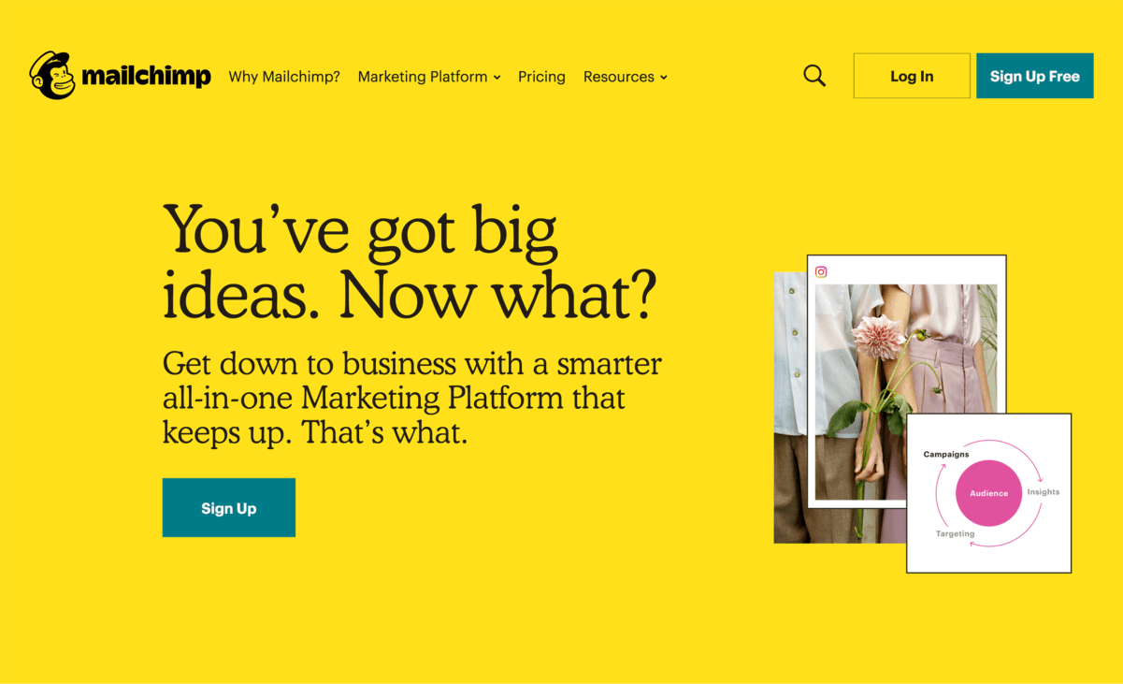
MailChimp Email Software
You can use MailChimp to send simple newsletters. Or it can be a full marketing automation platform that taps into behavior-based messages.
It’s one of the few platforms that lets you keep it simple. But if you do want to dig into more complicated stuff, you can.
Pricing is free up to 2k subscribers (with limited features). Their pro plans start at $10/month.

Slide 59
Marketing Automation 101
A lot of people consider marketing automation “the next big thing” in digital marketing.
Like any tool, automation is all about how you use it.
When you use it right, you can get your messages in front of the right people at the right time.
Which is MUCH better than mass emailing your entire list with the same exact message.

Slide 60
How to Create Awesome Auto responder Sequences
The content of your auto responder will be completely different for a blog vs. an ecommerce site vs. a SaaS company.
But they all have the same basic structure:

Slide 61
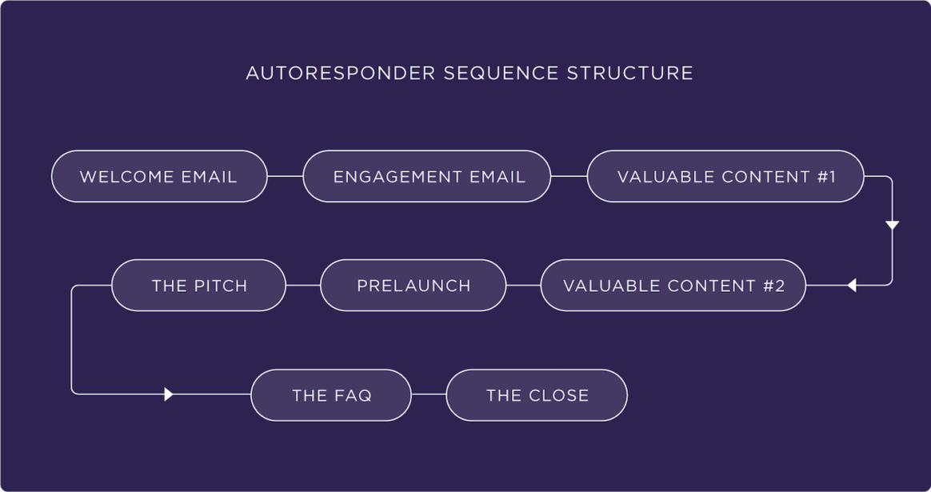

Slide 62
Once you get the hang of creating a basic auto responder, you can try using different auto responders for different people.
For example:
Let’s say you run a SaaS company that helps people make doctor’s appointments.
And you have two types of people that visit your site: doctors and patients.
Does it make sense to put a doctor and a patient in the same auto responder?
Nope!
Instead, you want to create a different auto responder for each group:

Slide 63
Set Up Segmentation
Segmentation is another easy way to get started with marketing automation.
Instead of putting people on different auto responders, you segment (or “tag”) subscribers based on behavior.
Then, send those segments SUPER targeted content.

Slide 64
Test Full Marketing Automation Campaigns
Let me be clear about something:
Marketing automation has a ton of potential.
But the downside of automation is that things can get REALLY complicated REALLY quickly.

Slide 65
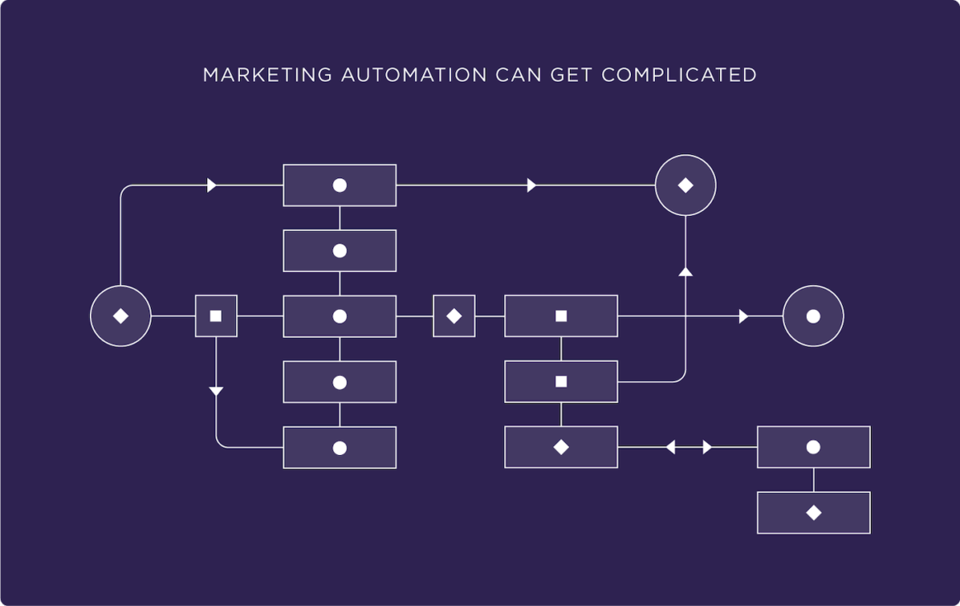

Slide 66
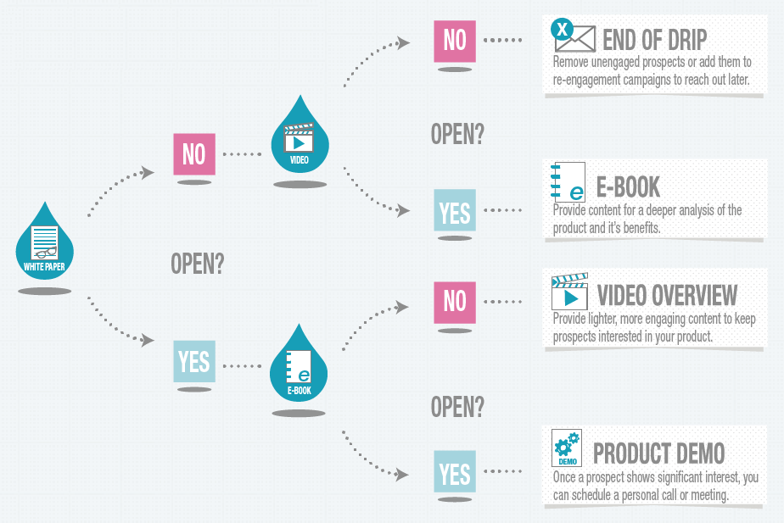

Slide 67
So if you’re new to email marketing, focus on building your list and sending subscribers AWESOME content.
And once you have a handle on that, set up an auto responder.
And once you have a handle on that, use tags to segment your list into 2-3 different groups.
Then, once you feel like you’ve completely mastered tagging, try full-on email automation.
This means hyper-targeted messages based on opens, clicks, pages visited, past purchases, demographics, time on site, and lots more.

Slide 69
Chapter 4: Control Track, Optimize & Improve

Slide 70
Tracking Email Marketing Metrics & KPI’s

Slide 72
Basic KPI’s
1. Delivery rate
How many people actually received your e-mail?
2. Open rate
indicates the percentage of sent or delivered e-mails which were actually opened.
3. Click rate (Click Through Rate CTR) measures the number of clicks compared to the amount of deliveries.
4-Click To open rate(CTOR) measures the number of clicks compared to the amount of Opened Emails.

Slide 73
Total 120 Email Sent
Delivery Rate 83 % (Delivered/Total)
Open Rate 10 % (Opened/Delivered)

Slide 75
5- Conversion Rate
How many people actually Purchases the product or did a specific Action.
6- Bounce Rate
Indicates the percentage of undelivered Emails.
7- Unsubscribe Rate Indicates the percentage of unsubscribed Cutomers.

Slide 86
How to Get Higher Open Rates
How to Improve Email Deliverability
Advanced Email Optimization Tactics

Slide 87
How to Get Higher Open Rates
1-Optimize Your Send Time
We DON’T recommend scheduling newsletters for first thing in the morning.
Otherwise, your message gets buried in someone’s crowded inbox.
Instead, send your emails out when your subscribers’ inboxes are empty. This is usually late morning or early afternoon
There’s no “best time to send an email” that works for everyone.
You need to test different send times to see which times get the highest open rates for you.

Slide 88
2-Send People a GREAT Welcome Email

Slide 89
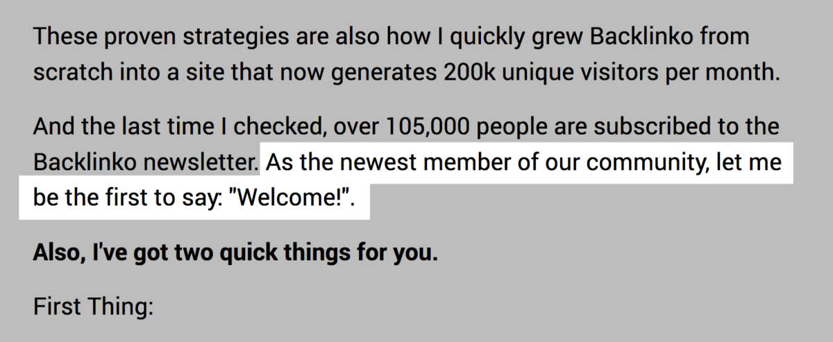

Slide 91
3-Follow “The 80/20 Rule” of Email Content
The 80/20 Rule of Email Content is simple: 80% of your emails should provide value. And 20% should pitch your products and services

Slide 92
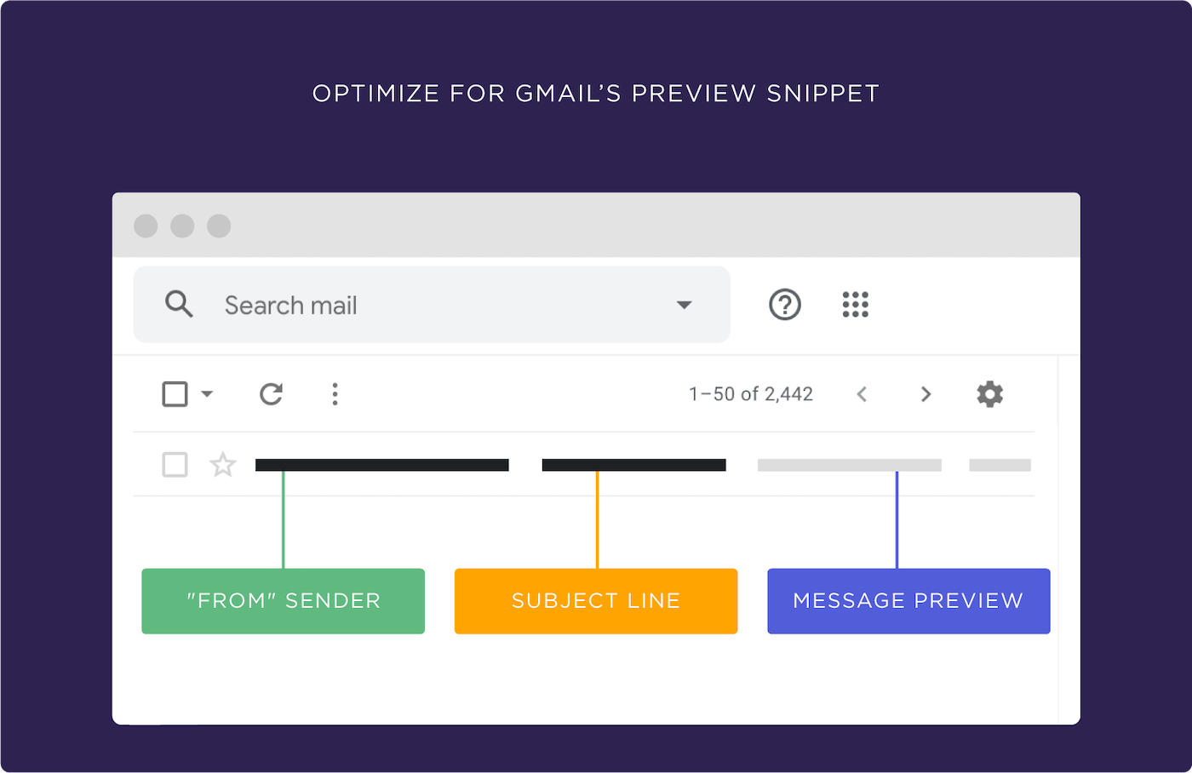
4-Optimize For Gmail’s Preview Snippet
When someone’s deciding whether or not to open an email, they look at three things:
The subject line
The sender
The message preview

Slide 95
How to Improve Email Deliverability

Slide 96
1- Delete Non-Openers
Something I’d been putting off for months:
List hygiene.
In other words: deleting unengaged subscribers.
I had to try it. I couldn’t let my open rates continue to freefall.
So I logged into mailchimp and deleted any subscriber that hadn’t opened an email in the last 4 months.
A few weeks later my open rates shot up like a rocketship

Slide 97
2-Keep Spam Complaints Low
Email services like Gmail, Yahoo and Outlook take spam complaints VERY seriously.
As they should.
If lots of people are marking your emails as spam, it sends a clear message that people don’t want to read your emails.
.
Tips that have helped my spam complaint rate stay insanely low (approximately 10 complaints per 100k emails):
First, make it REALLY easy to unsubscribe.
If you make someone hunt for an unsubscribe link, they’re going to give up and hit the spam button instead.
Instead, make your unsubscribe link super obvious:

Slide 98
Second, don’t send a bazillion emails.
The fact is, most people hit “Spam” out of frustration.
(Especially for newsletters that they signed up for)
And nothing frustrates people more than a non-stop barrage of emails.
So if you send more than one email per week, consider condensing that content into a single, weekly email.

Slide 99
(Note: There are exceptions to this rule. For example: you may want to send 5 emails in 5 days for a big promotion or limited-time product launch. Just don’t make daily emails a habit unless that’s what people signed up for)

Slide 100
Advanced Email Optimization Tactics

Slide 101
Try Text Email Layouts
Nathan Barry said it best:
“Beautiful email templates are bad for business.”
And he’s 100% right.
Fancy design does nothing but distract people from the content of your message.
Instead, I recommend sending emails that look like they came from a friend or coworker.

Slide 102
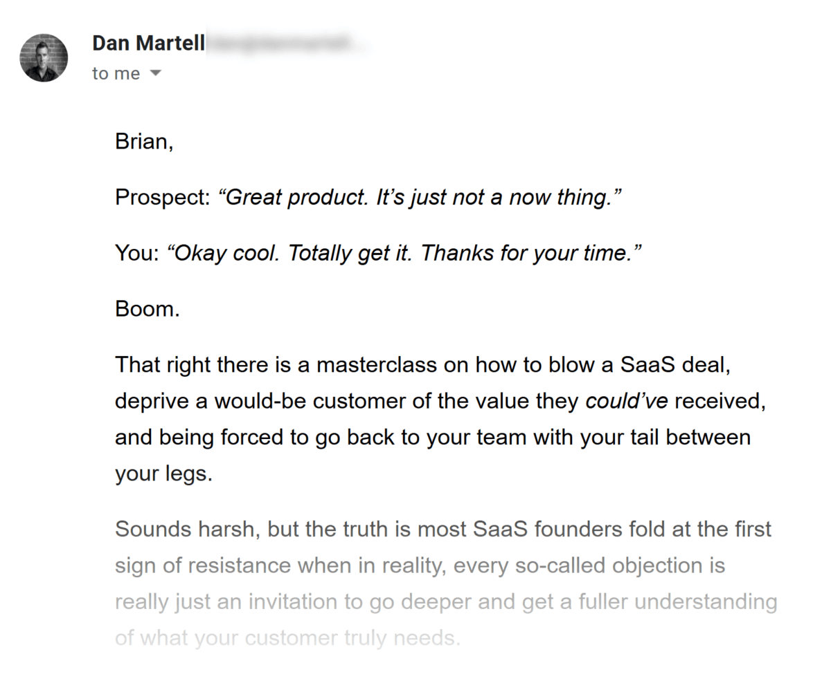
Here’s a great example from Dan Martell:
This email could EASILY have a logo, header and other nonsense.
But Dan decided to send a newsletter that’s super simple.
Nice.

Slide 103
Keep Things Personal
Most emails get ignored because they’re boring and generic.
What’s the solution?
Make your emails look like they’re written and sent from a single person.
(Yup, even if you’re a big brand with thousands of employees).
For example, HubSpot is a publicly traded company with hundreds of employees.
But even they send their newsletters from Aja, someone that writes for their blog.

Slide 104
One CTA Per Email

Slide 105
Use 15px+ Font
According to Litmus, 67% of all email messages are opened on mobile.
And one of the easiest ways to make your newsletters mobile-optimized?
Use a big font. (Ideally, 15px+).
Unfortunately, most newsletters still use 12-13px font.
This is fine for desktops.
But 12px font is almost impossible to read on an iPhone without pinching and zooming.

Slide 106
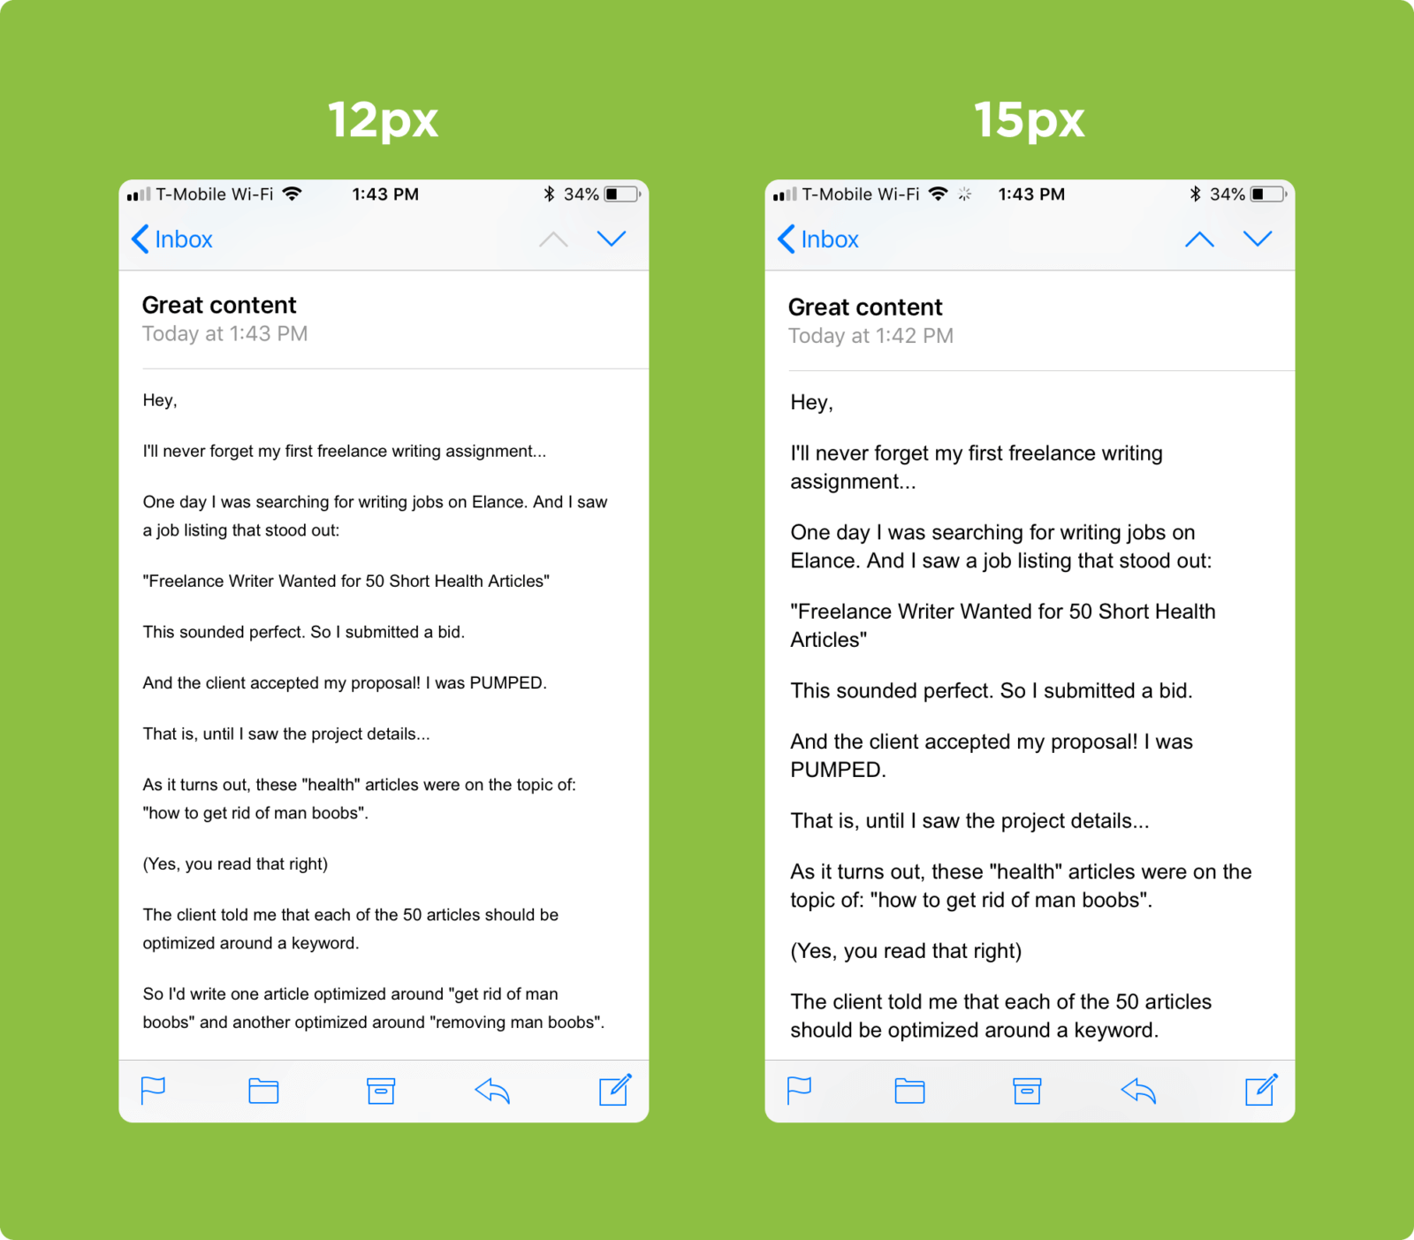

Slide 108
General Copywriting tips

Slide 109
Chapter 5 (Bonus Chapter) Mailchimp Software Step by Step Guide

